Slide 1





DATA SCIENCE
PROJECT PRESENTATION
-by : AGRANSH RASTOGI ,
ARNAV SRIVASTAVA ,
HARSHIT GARG ,
HARMANPREET SINGH ,
VISHAL DIXIT ,
VIKAS SINGH RAJPUT

Slide 2
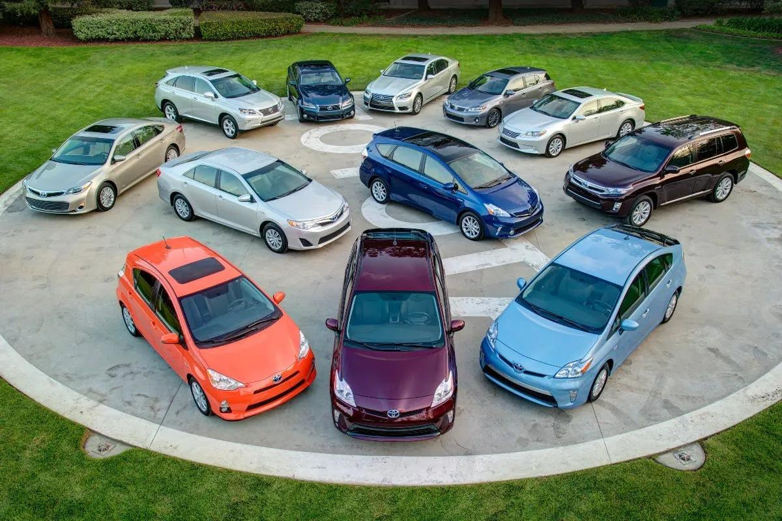

Topic :
CAR PRICE PREDICTION
In this project we tried to predict the Car Price of used cars by their information from dataset car data.csv using Linear Regression .

Slide 3
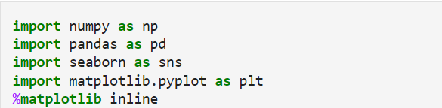
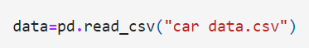
CODE FOR MODEL
Importing libraries Numpy , Pandas , Seaborn , Matplotlib.
Reading dataset "car data.csv"

Slide 4
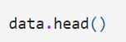
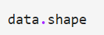
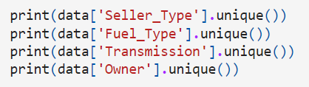
CODE FOR MODEL
Displaying top 5 rows
Displaying shape
print unique values in specified feature types.

Slide 5
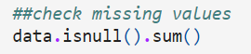
CODE FOR MODEL
Check description of numeric variables .
Displaying shape
Dropping Car_Name feature in final dataset as it is not required .

Slide 6
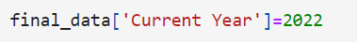
CODE FOR MODEL
Adding a column 'Current Year' =2022.
Adding 'no_year' as calculated by ' Current Year ' - ' Year ' values
Dropping ' Year ' as it is not required .
get_dummies used to convert feature into One Hot Encoding. .

Slide 7
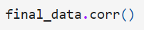
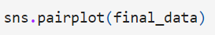
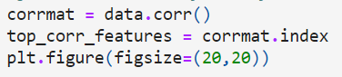
CODE FOR MODEL
This shows how one feature is related to another.
To plot graph using Seaborn.
Get correlation of each dataset.
plot heatmap.

Slide 8
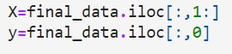
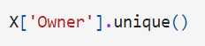
CODE FOR MODEL
Independent & Dependent Feature.
Splitting x , y to training & testing

Slide 9
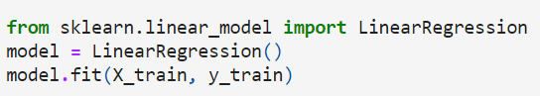
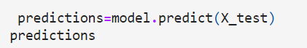
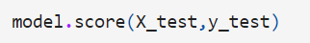
CODE FOR MODEL
Linear Regression ( )
Predicting price
Accuracy ~ 85%

Slide 10


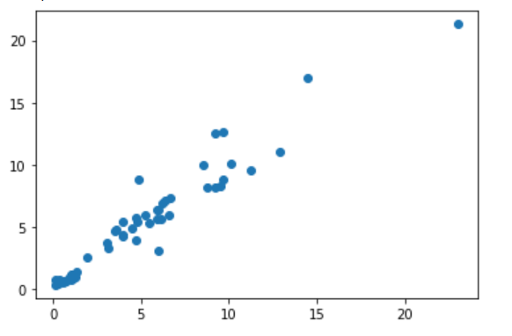
Scatter Plot
A scatter diagram is an extremely simple statistical tool used to show a relationship between two variables.
It is often combined with a simple linear regression line used to fit a model between the two variables.
This scatter plot is between y_test & predictions.

Slide 11

Project Overview
25
Frontend
20
HTML ,JS ,CSS.
Backend
15
Machine Learning Libraries
Final Deployment
10
Heroku
5
We got Accuracy of about 85%
0
Item 1
Item 2
Item 3
Item 4
Item 5

Slide 12
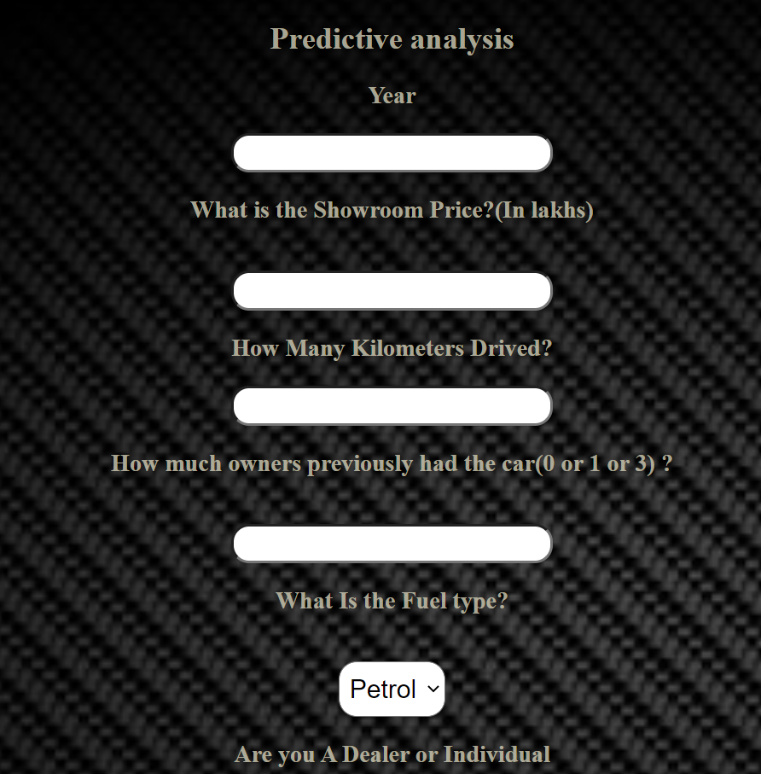
With
Deployment
https://car-pric-predict.herokuapp.com/

Slide 13
THANKS
FOR WATCHING

